Slide 1

AlgoPi
Empowering students to succeed in their careers
Chris Hunter, Zain Farhat,
Zuhuang Wang, Sofia Yang
S1. Chris

Slide 2
Who are we?
Competitive programming community (75+ members)
Software development & Algorithm design
S2. Chris
Notes:
Active community in IIT of 75+ members who are passionate about software development and algorithm design

Slide 3
Problem Statement
How can we help IIT CS students develop their problem solving & analysis skills to gain their first career position as a software engineer?
S3. Chris

Slide 4
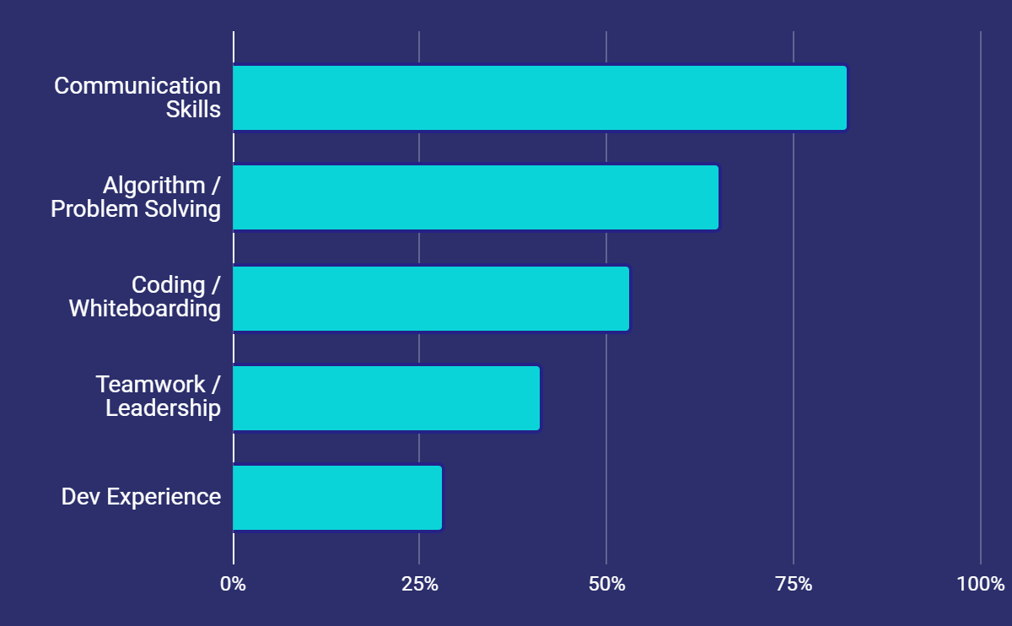
Challenging Aspects of Seeking Early-Career Positions

Slide 5
Solution
Develop a standardized procedure for effective problem solving + analysis
Organized, multi-track method of improving skills, including hands-on events
Community-based feedback system + improvement tips
S4. Sofia

Slide 6
Brute force method for just solving interview
problems
emphasis on results vs process.
Status Quo
Our Solution
Streamlined learning approach
Methodical procedure for problem-solving / analysis.
Emphasis on teamwork and communication
S5. Sofia
Notes:
(Solve 50 problems, read through a 1000 page textbook)
with resources and hands-on experiences.

Slide 7
Testing Our Solution
‘Prototyping’ and testing aspects of our solution:
Problem of the Week
Virtual Whiteboarding
S6. Zuhuang
Notes:
Go in detail. Sorry for not adding more content to this slide.
Talking about how much participant we had in the first few week then the energy seems to wear off
The whiteboard events explain a little bit more about what is the whiteboard event.
In actual interview, mock interview session, that we present interview problems to the participants and have them solve out the problem explain their thought process, and solution.

Slide 8
Results + Future
Problem of the Week + Whiteboarding
Problem of the Week: Success
Whiteboarding Event: Failure
Future
Grow as a community on campus and host in person activities
Develop concrete roadmap to help IIT students

Slide 9
Results
Problem of the Week
Tested ~5 weeks
50+ solution submissions
Over 70% had explanation / comments
Positive feedback from community for practicing problem-solving techniques
S7. Zain

Slide 10
Results (2)
Whiteboarding Event
Due to the team’s inexperience with hosting events, This time the test was unsuccessful.
From sampling 15 members:
73% were unable to attend due to to schedule conflicts.
~30% were unsure of the event’s difficulty level.
66% expressed interest in future events.
Although the number of participants were limited, participants expressed satisfaction with the event, and found it to better than their previous learning approaches.
S8. Zain

Slide 11
Future
Develop more asynchronous events / experiences
Create different learning tracks to help students of all skill levels
Improve current resources/content into a comprehensive roadmap
Continue to actively engage and seek feedback from our community
S9. Zain

Slide 12
Thanks!

